Slide 1

Human Resource Management
Notes:
Complex management activity that includes:
planning production
organizing resources
directing operations and personnel
monitoring system performance
Improves productivity and allows the organization to meet the competitive priorities of customers

Slide 2

Human Resources Management
The HRM process consists of planning, attracting, developing, and retaining the human resources (employees) of an organization.

Slide 3
Definition
Human Resource Management is the planning, organising, directing and controlling of the procurement, development, compensation, integration, maintenance and separation of human resources to the end that individual, organisational, and social objectives are accomplished.
- Edwin B. Flippo

Slide 4
Scope of HRM
Job Design
Prospects
Procurement
HRM
Industrial
Relations
Remuneration
Maintenance
Motivation

Slide 5
Human Resources Management
HR Planning
strategic HR planning; job design
Retaining employees
compensation; maintenance; labor relations; separation
Attracting employees
recruiting; selecting
Developing employees
training & development; performance appraisal

Slide 6

HR Planning
Planning for the future personnel needs of an organization,
taking into account both internal activities and factors in the external environment

Slide 7
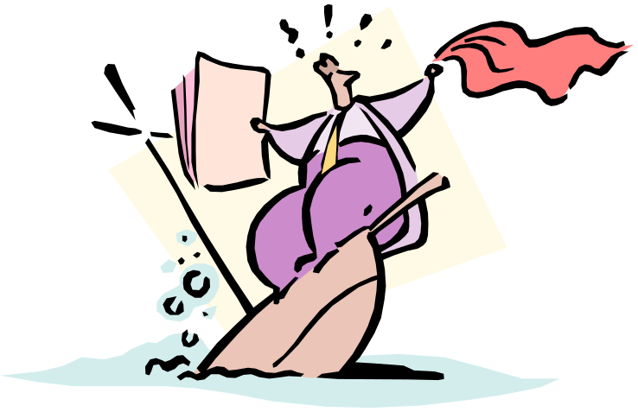
HR Planning
Job Design
  usually done prior to recruitment
  the process of describing the work that needs to be done by an employee and
  specifying the requirements needed in fulfilling the job

Slide 8

Attracting Employees
Recruitment
  development of a pool of job candidates in accordance with a human resource plan
  its purpose is to provide mgmt. with enough candidates from which they can select qualified employees
  internal versus external

Slide 9
Attracting Employees
Selection
  the mutual process whereby the organization decides to make a job offer and the candidate decides whether or not to accept it.

Slide 10
Steps in selection
Job Offer
Physical Exam
In-depth Interview
Background Investigation
Testing
Initial Interview
Job Application

Slide 11

Developing Employees
Orientation
  a program designed to help employees fit smoothly into an organization

Slide 12

Developing Employees
Training
  a process designed to maintain or improve current employee performance
Development
  a process designed to develop skills and attitudes necessary for future work

Slide 13

Developing Employees
Performance Appraisal
  process of providing feedback to subordinates regarding their performance on the job.
  Informal versus Formal

Slide 14
Developing Employees
A formalized appraisal process is used for:
  rating work performance
  identifying those deserving raises or promotions
  identifying those in need of further training

Slide 15

Retaining Employees
Compensation
the adequate and equitable remuneration of personnel for their contribution in the achievement of organization objectives.

Slide 16

Retaining Employees
Labor relations
entails recognizing the validity of unions, negotiating for the collective bargaining agreement, and being able to handle strikes and other forms of mass action.

Slide 17

Retaining Employees
Maintenance
the process of providing the following services to employees:
  career counselling
  safety & health programs
Also involves the minimization of absenteeism and tardiness

Slide 18

Retaining Employees
Separation
the process of reintregrating employees to society; entails the following:
  employees should be terminated for a just cause
  a retirement plan must be provided for old employees as an aid when they leave the company.

Slide 19
THANK YOU

